Slide 1
Crimson Clubs
Adam Gabriel, Max Livingston, Travis Redfield, Maclane May, Taylor Meads

Slide 2
Description Review

Slide 3
Definitions
Admin User – Club leaders, officers, faculty advisors, etc. who have more privileges for a specific club than others. Doubles as a standard user.
Standard User – A normal user with normal privileges.

Slide 4
Functional Requirements (Admin)
Add other people/Approve people
Create Events
Push Notifications
Remove People
Modify Description/Info/Tags
Add Stats (Low)

Slide 5
Functional Requirements (Normal)
Request to Join Club/Join Club
Search Clubs
Look at Personal Calendar
Leave Clubs
Look at info
Create Profile
View Event Stats/Leagues (Low)

Slide 6
Non-Functional Requirements
Login
Save to backend
Flexible UI for website and app
Profile Management (?)
Search Algorithm based on Profile/Tags (?)

Slide 7
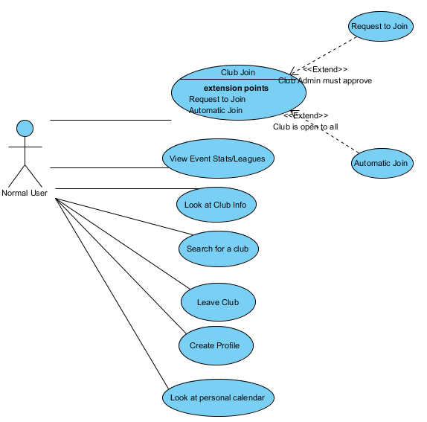
Normal User Use Case Diagram

Slide 8
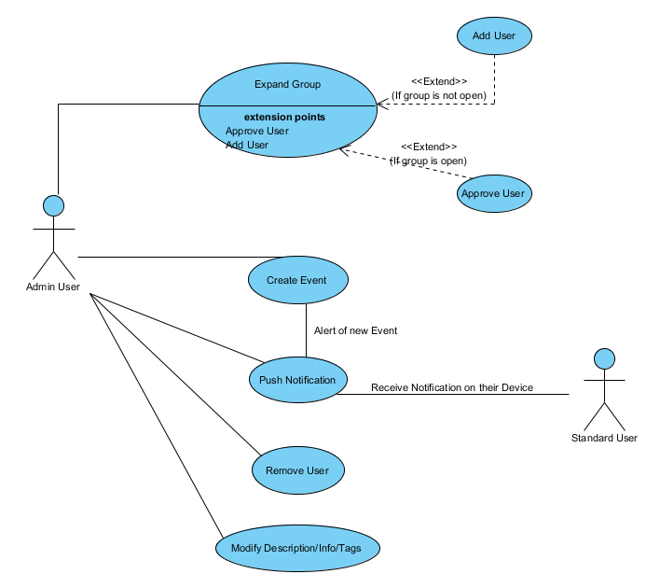
Admin User Use Case Diagram

Slide 9
Class Diagram

Slide 10
Activity Diagrams

Slide 11
Database Diagram

Slide 12
System Evolution

Slide 13
Potential Risks

